Slide 1

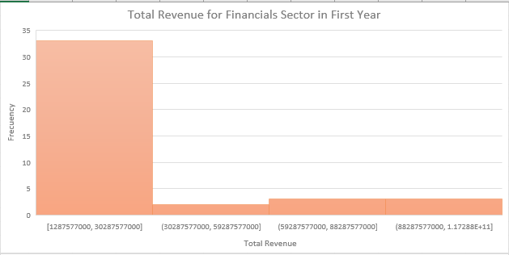
Total average revenue is above average
Task 1
What is The Total Revenue for Financials Sector in First Year ?
We have a graph of total financial sector revenue for the first year. We notice that the following figure is skewed to the right because the total average revenue is above average and the Mean>Median>Mode, and the total revenue in the first year is 878187750000 and the standard deviation of the total is 10259000000 which is very high, If the standard deviation is high, it means that the values ​​are distributed as the figure shows the largest and smallest value, where the largest value is equal to 19482858 and the lowest value is 1.484848 and the range is 98790423000It is high, which means that there is a lot of variety

